Slide 1
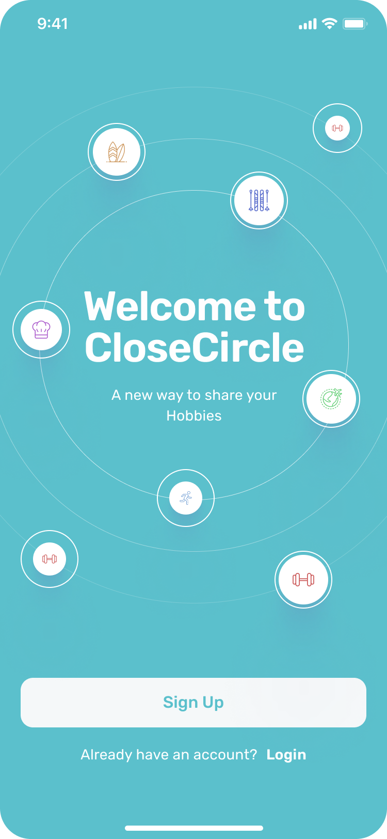

CloseCircle: A new Social Media
Created By Aria Askaryar
April 25, 2023

Slide 2
Be a first beta tester
Send me your email for when the first launch occurs, you can be one of the first users
ariaaskaryar18@gmail.com

Slide 3
Vision
Our mission is to revolutionize social media as we know it by creating a platform that celebrates and connects people's unique hobbies, passions, and talents. Our vision is to shift the focus from following individuals to following what people love to do, and to provide a space where users can create, share, and showcase their hobbies in new and exciting ways. We aim to redefine what social media means by introducing a fresh, innovative platform that fosters creativity, inspires growth, and connects people with like-minded individuals who share their interests.

Slide 4
What's New
We're excited to share the latest updates on our app's progress. Our team has completed the app's functionality, design, and database setup, ensuring a smooth user experience. However I started on creating machine learning models to enhance the app's intelligence and deploying the app to the market. The ML model will now have image identification and text recognition. Additionally, we haven't yet integrated users into the app, but we're actively working towards it. Rest assured that we're making significant progress and will continue to keep you updated on our app's development.

Slide 5
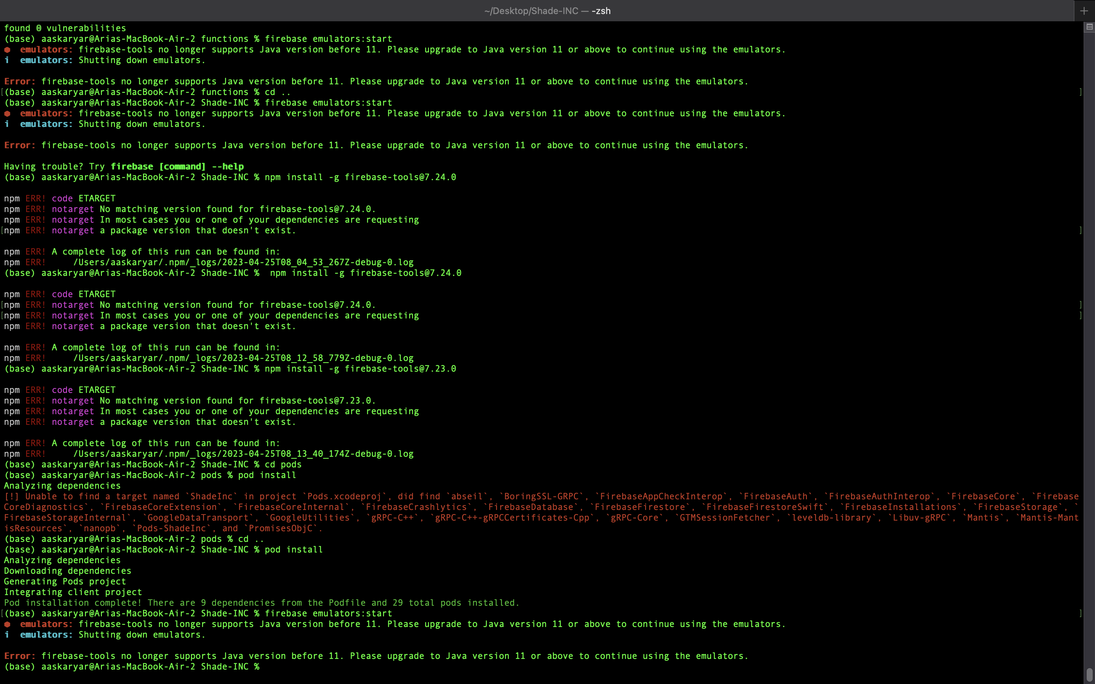
Set Backs
Unable to complete machine learning model within set timeline
Delay in app deployment to market
Incompatibility of computer with Java 11 for deployment
Major setback for Project
Mac M1 chip

Slide 6
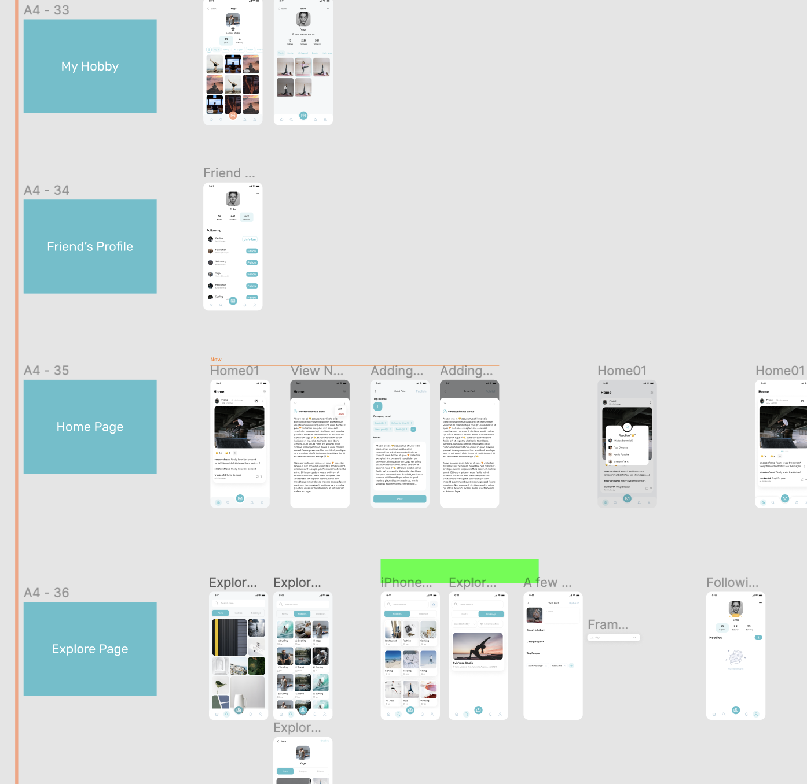
Future
In future installments, I plan to continue developing and completing our social media app by implementing key features such as the Machine Learning Models, and Deployment. Additionally, I will focus on getting the deployment done.

Slide 7
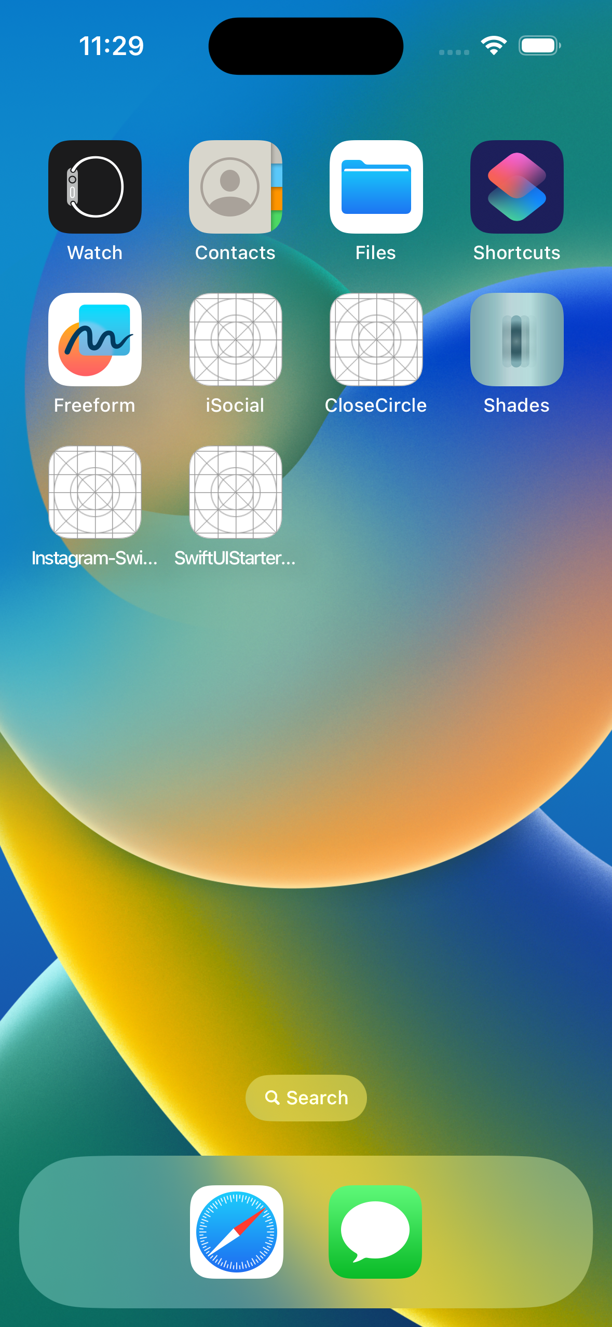
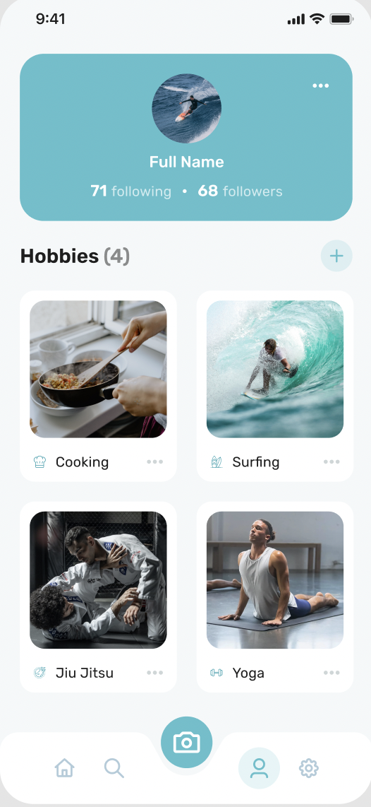
App
Lets Go See a Live DEMO

Slide 8

Video
https://www.youtube.com/watch?v=rVG4jetGPpU&feature=youtu.be

Slide 9
Questions?

